Slide 1
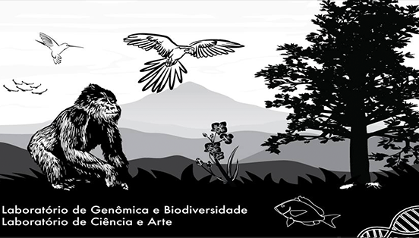


LOW-BUDGET SCIENCE AND THE PRODUCTION OF COMPLETE AND NEARLY-COMPLETE MITOGENOMES OF TEMNOTHORAX ANTS USING PUBLIC DATA
Gabriel Alves Vieira & Francisco Prosdocimi
Laboratório de Genômica e Biodiversidade
Instituto de Bioquímica Médica Leopoldo de Meis
Universidade Federal do Rio de Janeiro
Notes:
1

Slide 2
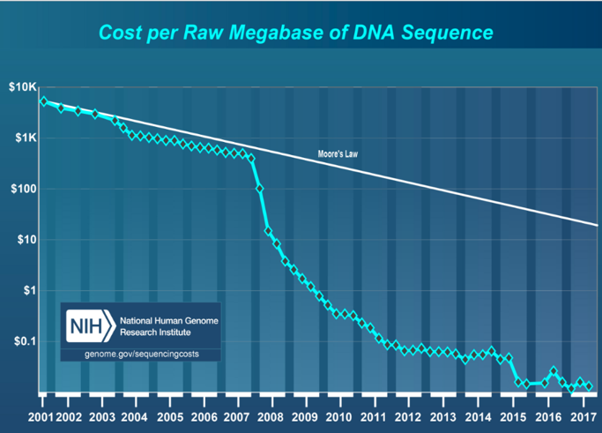
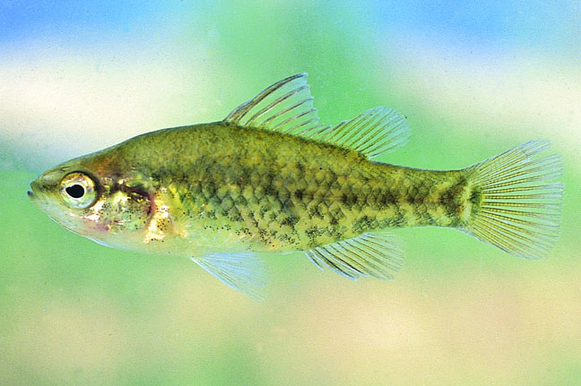

Introduction - NGS and public data
Next-Generation Sequencing (NGS)
↑ genomic data produced
↓ cost per sequenced base
Journals: Incentivates raw data publication
Reproducibility
Growth of public sequencing databases
Notes:
2

Slide 3
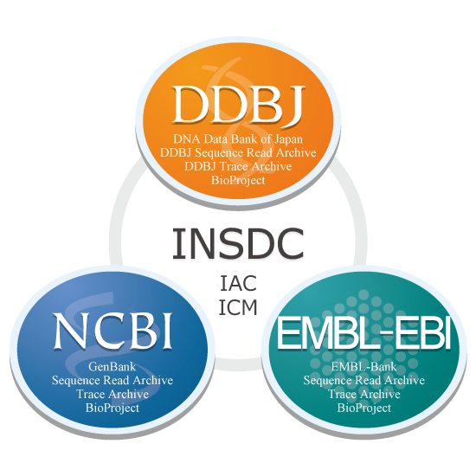

Sequence Read Archive (SRA)
Part of an international colaboration (INSDC)
3 databases:
SRA: NCBI Sequence Read Archive
ERA: EBI Sequence Read Archive
DRA: DDBJ Sequence Read Archive
Synchronized
Several types of sequencing data:
DNA-seq; Bisulfite-seq; RNA-seq...
Enormous potential for “recycling”
Scientific advances at low costs
Notes:
3

Slide 4
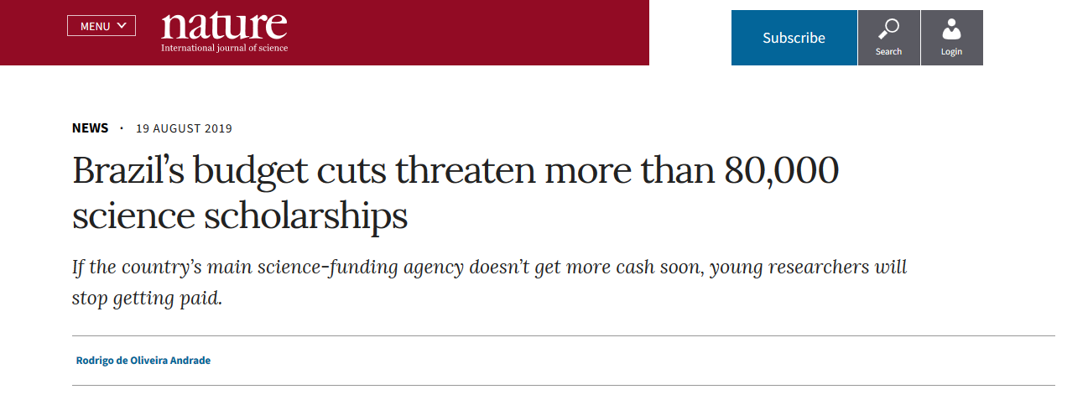
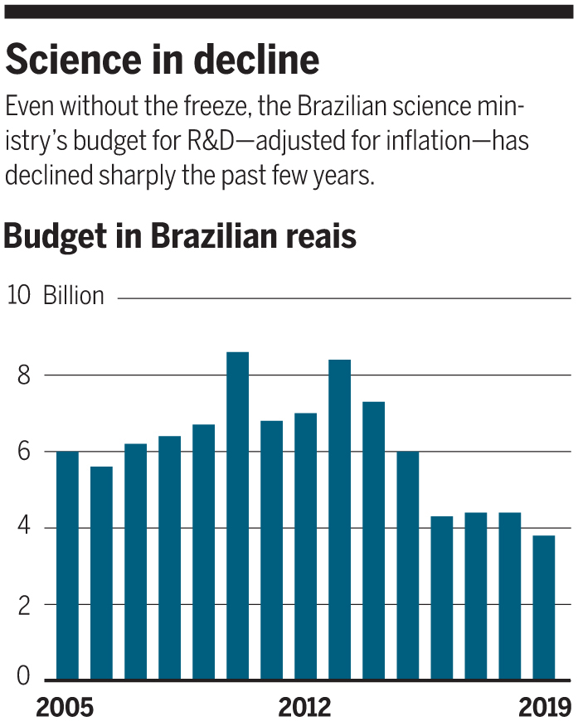
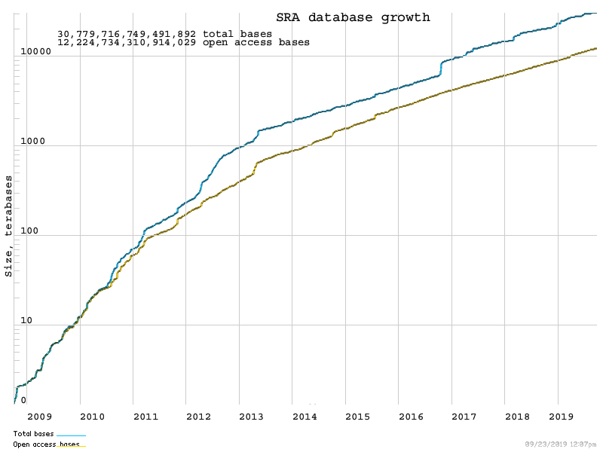
Brazil: ↓ Scientific funding
↑ Public sequencing data
How can these datasets foster new research?

Slide 5
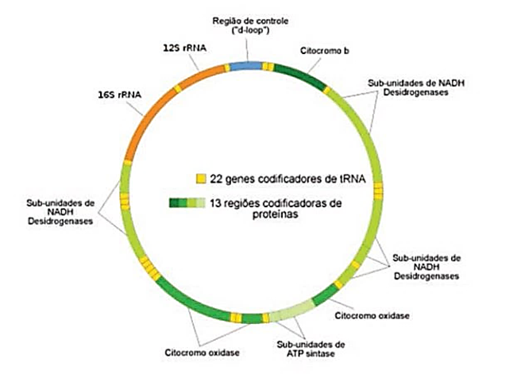
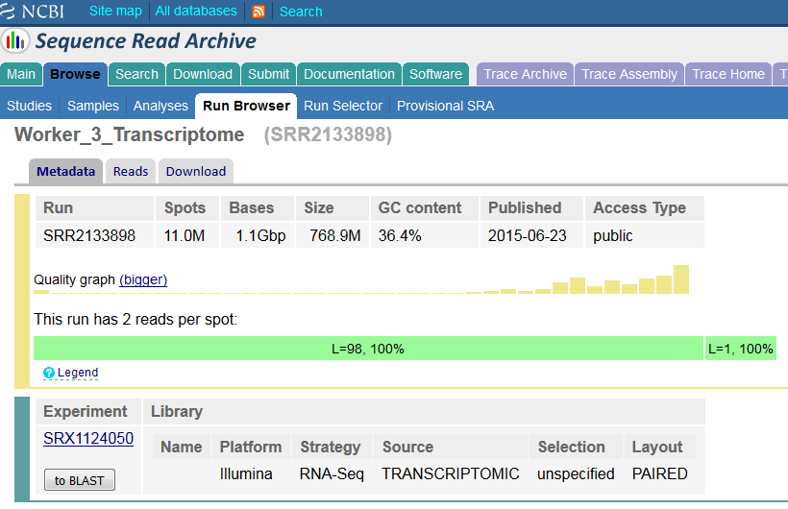
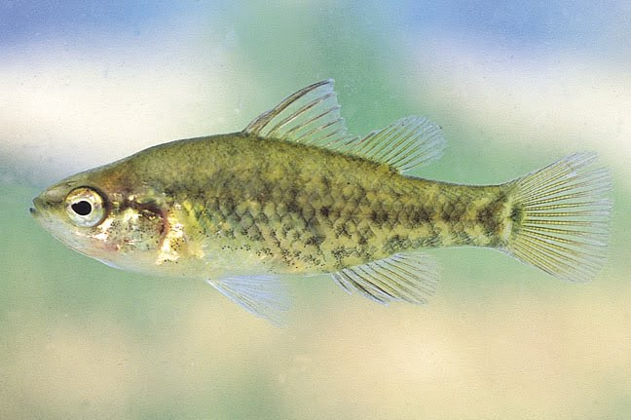
Public data and mitogenomics
Data used to answer a specific question
Not related to the mitogenome
Sequencing
Mitochondrial sequences often present
1 in each 200-1000 sequences is mitochondrial
Many species with public data available and no mitogenome published
This data could be used to assemble the mitogenome
Phylogenetics (Krzemińska et al., 2017)
Phylogeography (Fields et al., 2018)
Populational genetics (Kilinç et al., 2018)
Conservation (Rosel et al., 2017)
Notes:
5
5

Slide 6
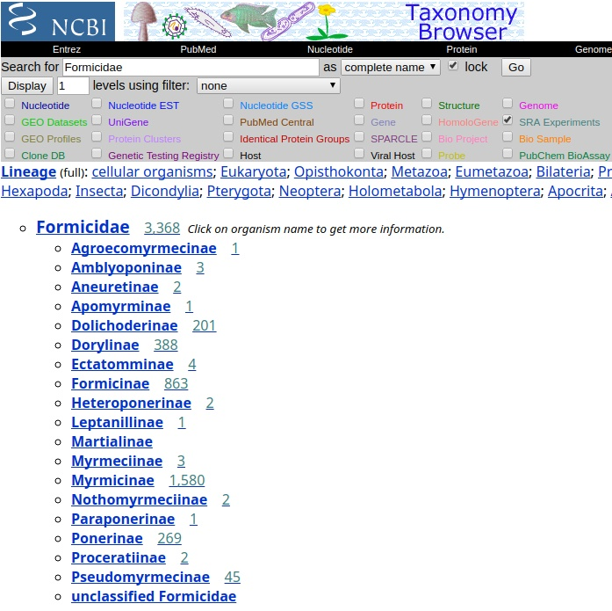
Ants (Hymenoptera: Formicidae)
More than 13000 spp.
Huge amount of genomic sequencing data for the clade
≈ 3.91 Terabytes
35 complete mitogenomes
Why not use this data?
Notes:
6

Slide 7
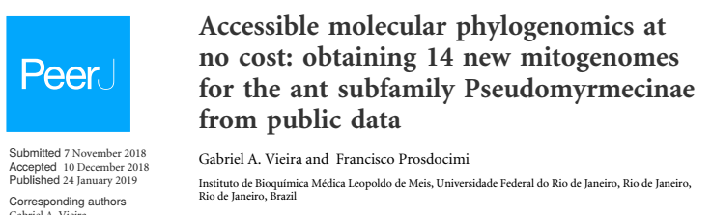
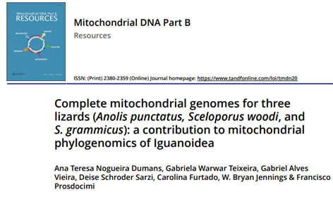

Slide 8
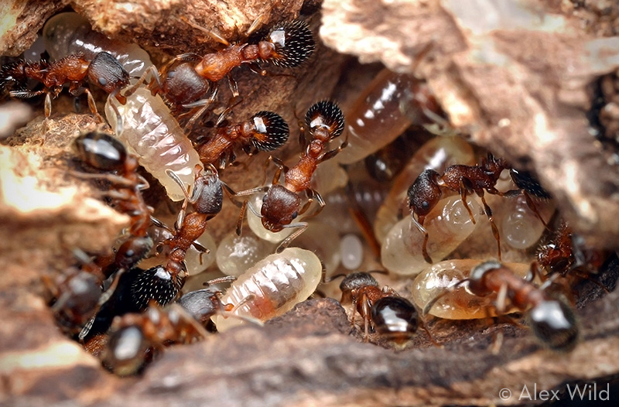

Temnothorax spp. – Myrmicinae subfamily
Highly diverse - 408 spp. (AntCat)
Unclear taxonomy and evolution
Model organism – Social insects
Ecology (Blatrix & Herbers, 2003)
Beahviour (Charbonneau et al. 2015)
No mitogenome described
Prebus (2017)
UCE Datasets:
37 Temnothorax spp.
13 outgroups
How to use these datasets?

Slide 9
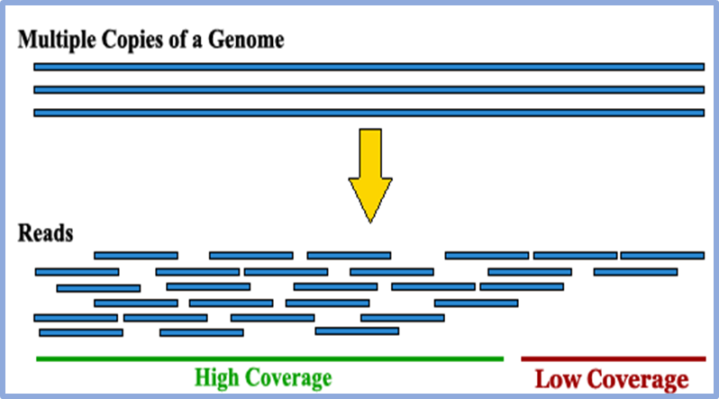
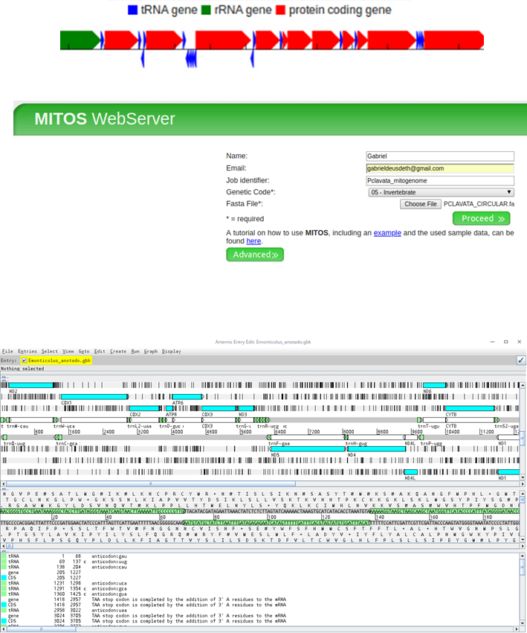
Material and Methods
Downloaded data from ERA (SRA file format)
Converted data to fastq
Assembly
NOVOPlasty (primary assembly)
MITObim (close gaps and refine assembly)
Assembly check: TABLET
Coverage
How many sequences corroborates the assembly
Circularization
Anotation:
Identification of specific regions in a genome (Ex. Genes)
Automatic: MITOS Web Server
Manual: Artemis (NOT FINISHED)
Notes:
Para gerar predições de genes na montagem de scaffolds do papagaio-de-fronte-azul com base em primeiros princípios, ou ab initio, foi utilizado o AUGUSTUS [65], um preditor de genes ab initio que aprende a identificar genes com base na semelhança estrutural com genes fornecidos em um conjunto de treinamento. Usamos o SABIA [66], um pipeline de anotação automática, para anotar todas as predições de genes com uma janela aberta de leitura (ORF) válida, tendo em conta resultados de BLAST com similaridade com sequências em vários bancos de dados.

Slide 10
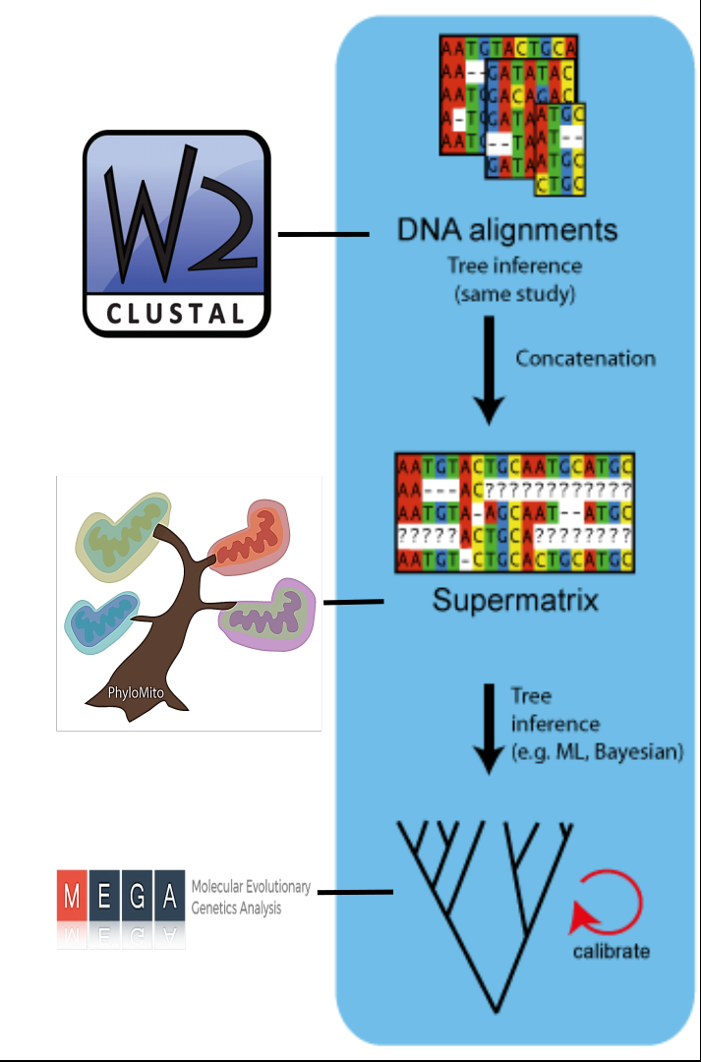

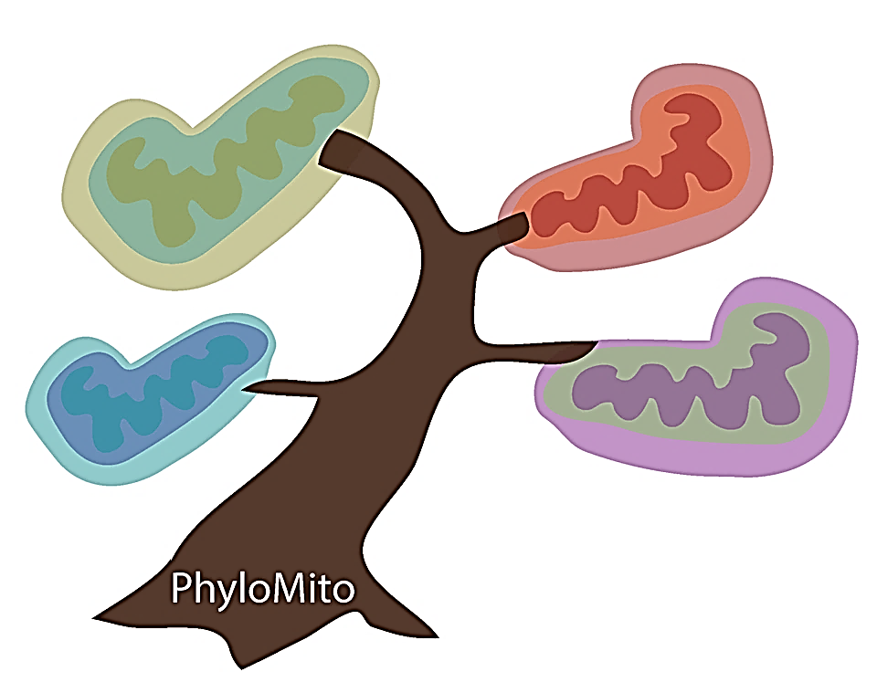

Phylogenomics
Mitogenomes:
Temnothorax spp.
Ants previously described
Outgroups (bees)
Supermatrix:
13 protein-coding genes
Aligned and concatenated
Phylogenomics inference:
Neighbor Joining
Ressampling: Bootstrap (1000 replicates)
Notes:
10

Slide 11
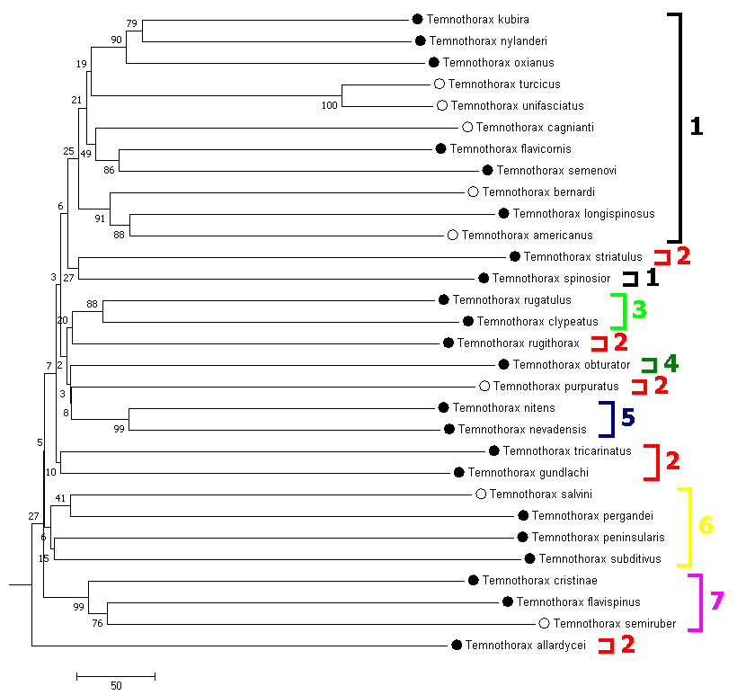
Results
Temnothorax spp.:
30 mitogenomes
22 complete
8 partial (nearly complete)
Monophyletic genus
Highly supported
Basal nodes
Low bootstrap support
Paraphyly
2 out of 7 clades
Mitogenomes:
● Complete
○ Partial
Clades:
1 - Palearctic* 5 – andrei
2 – sallei * 6 – salvini
3 – rugatulus 7 – rottenbergi
4 – obturator

Slide 12
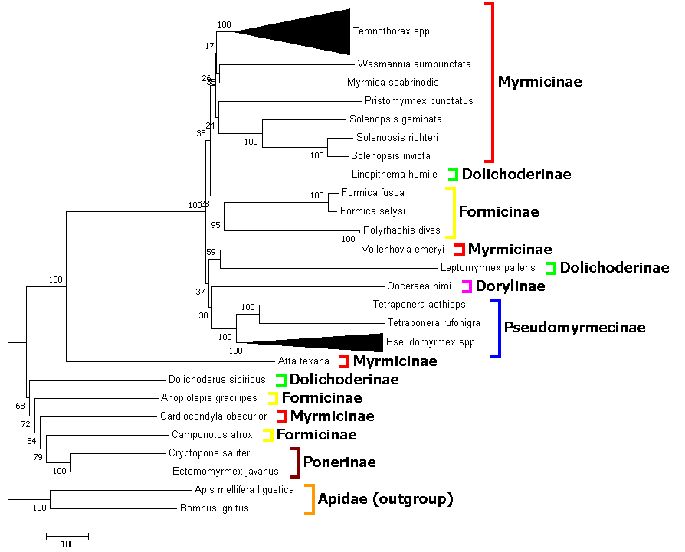
Results
Formicidae Tree:
Monophyletic clades
Pseudomyrmecinae
Ponerinae
All genera
100% BS support
Low bootstrap values
Myrmicinae nodes

Slide 13
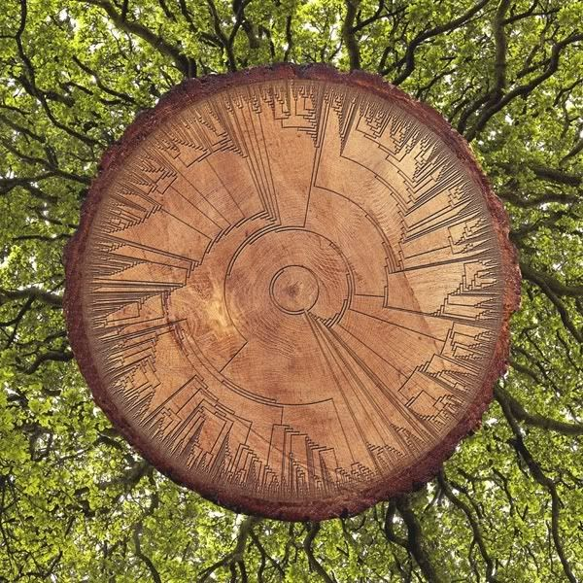
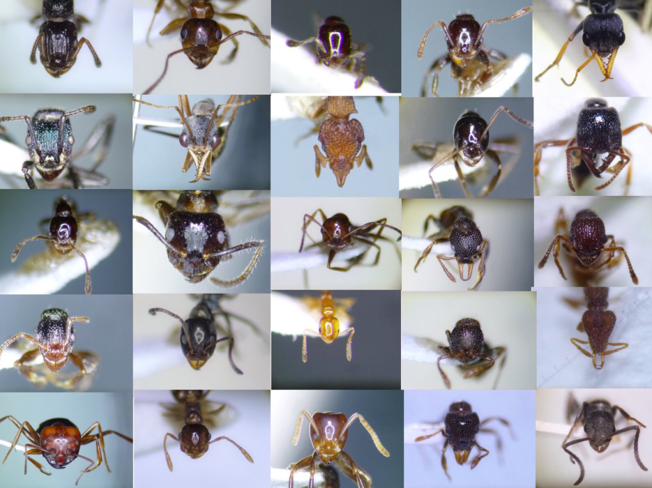
Discussion
Overall:
Moderate phylogenetic inference accuracy
All genera monophyletic
Good resolution – resolve shallow nodes
Low bootstrap values
Mostly in Myrmicinae – hyperdiverse
Improved taxonomic coverage
More robust tree inference methods
Resolve paraphyletic relationships
Also applicable to poorly support nodes in Temnothorax genus
Next steps:
Mitogenome assembly (outgroup species)
Manual curation
Maximum Likelihood
Synteny and comparative genomics analyses
Notes:
13

Slide 14

Conclusion
This preliminary study:
Obtained and analyzed Temnothorax mitogenome sequences for the first time
No sequencing costs
Illumina ‘partial genome’ run: ≈ 2.000 R$ per sample
30 mitogenomes: 60.000 R$ saved!
Free bioinformatics software
4 GB RAM – No supercomputer required
NO/LOW BUDGET MITOGENOMICS
MitoFree – Automatic assembly tool
Contribution to ant mitogenomic resources
Highlight the untapped potential of public databases
Inspire similar works
↑ mitogenomes : Evolution and Conservation (Non-model)
Notes:
14

Slide 15
REFERENCES
Blatrix R, Herbers JM. Coevolution between slave-making ants and their hosts: host
specificity and geographical variation. Mol Ecol. 2003;12:2809–16.
Charbonneau D, Hillis N, Dornhaus A. ‘Lazy’ in nature: ant colony time budgets show
high ‘inactivity’ in the field as well as in the lab. Insect Soc. 2015;62:31–5
Fields, Peter D., et al. "Mitogenome phylogeographic analysis of a planktonic
crustacean." Molecular Phylogenetics and Evolution (2018).
Kılınç, Gülşah Merve, et al. "Investigating Holocene human population history in North
Asia using ancient mitogenomes." Scientific reports 8.1 (2018): 8969.
Krzemińska, Urszula, et al. "Population mitogenomics provides insights into
evolutionary history, source of invasions and diversifying selection in the House Crow (Corvus splendens)." Heredity 120.4 (2018): 296.
Rosel, Patricia E., et al. "Examining metrics and magnitudes of molecular genetic
differentiation used to delimit cetacean subspecies based on mitochondrial DNA control region sequences." Marine Mammal Science 33.S1 (2017): 76-100.

Slide 16

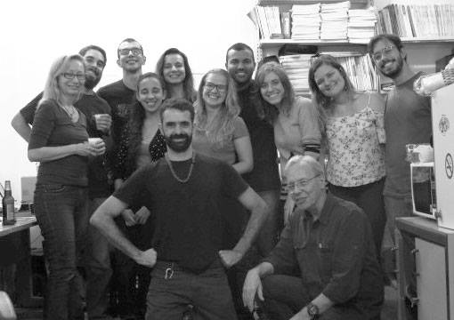

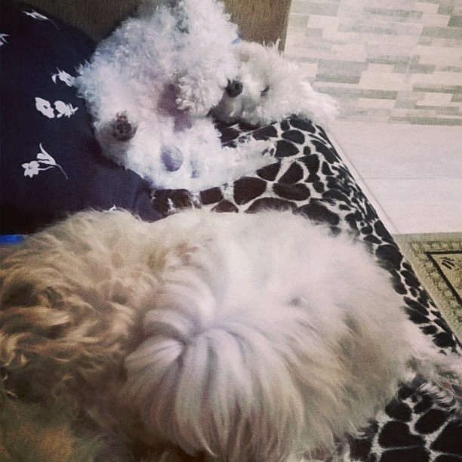

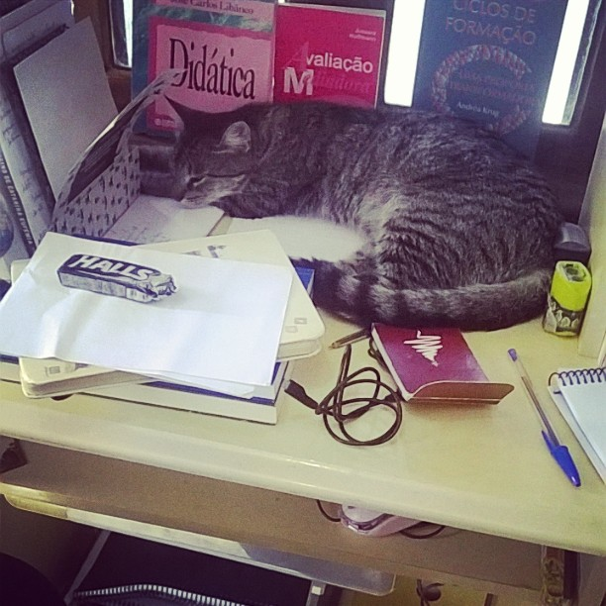
OBRIGADO!
Email: gabriel.vieira@bioqmed.ufrj.br
Notes:
16
16

